Slide 1
EconIndia : Indian Economy
Analysis Website
Navkar Shah Aayush Durgule Saksham Raina
16010120189 16010120203 16010120204

Slide 2
Motivation
Problem in Current Working Websites :
Time Lag in Analysis
Biased
Spread False Propaganda
Inaccuracy in Analysis
Advertisement Overload

Slide 3
Problem Statement
The aim of the project is to create a platform that provides comprehensive information and analysis on the various aspects of the Indian economy, including macroeconomic indicators, sectoral performance, policies and reforms, trade and investment opportunities, and the social impact of economic growth.
The website aims to educate and empower users with accurate and real time data and insights with the help of various Machine Learning Algorithms and Data Mining Techniques, helping them make informed decisions and contribute to the development of the Indian economy.

Slide 4
Why our website?
Excellent UI (No Ads Interface)
More Accurate Analysis (>0.65)
Easy Access to Insights (No Subscription Fee)
Predicting Growth Trends (Machine Learning)
Available for person with disability (Text to Speech)

Slide 5
Literature Survey

Slide 6
Sr No | Name of Paper | Summary | Pros | Limitations
1 | Implications of AI on the Indian Economy | The research journal shows us how AI is used in various fields like Agriculture , Manufacturing, Healthcare , Banking , Retail , Education , Legal Services , Transport , Media which in turn boosts the Indian Economy. | Increased use of AI in various industries can lead to higher productivity, efficiency, and cost savings. | There may be ethical concerns surrounding the use of AI, such as bias and privacy violations, that need to be addressed to ensure responsible deployment.
2 | Economic Activity Forecasting based on the Sentiment Analysis of News | This paper shows us how positive and negative sentiments affect the economy and hence analyzing the sentiments through ML techniques results in getting data of real time growth of economy rather than using traditional parameters like GDP , Purchasing Power Parity , Per capita income etc | Analyzing sentiments using ML techniques provides real-time data of the economy's growth, which can help policymakers make more informed decisions. | Sentiment analysis is not always accurate and may be influenced by factors such as bias and noise.
3 | Review on Study and Usage of MERN Stack for Web Development | The research paper explains how to use MongoDB , Express , React JS and Node JS for development of our website. It will help us in defining the basic structure of development of our website. | Using MongoDB, Express, React JS, and Node JS can help create a more efficient and robust website. | The use of multiple technologies can make the website more complex and difficult to maintain.

Slide 7
Sr No | Name of Paper | Summary | Pros | Limitations
4 | How Can the Artificial Intelligence of Things Create Public Value? Lessons Learned from Use Cases | The research paper addresses how Artificial Intelligence of Things can be used in government sectors to create public value and how it can change government operations. | The use of Artificial Intelligence of Things (AIoT) in government sectors can improve public services, increase efficiency, and reduce costs. | The use of AIoT in government may raise privacy and security concerns regarding the collection and use of personal data.
5 | Cashless Payment Policy and Its Effects on Economic Growth of India: An Exploratory Study | The research paper discusses the long-term impact of a cashless economy. The research paper discusses the increase in cashless transactions in recent years and its impact. | A cashless economy can increase efficiency and reduce transaction costs for businesses and consumers. | Certain groups, such as the elderly and those living in rural areas, may have limited access to cashless transactions, which could exacerbate existing inequalities.
6 | Application of Machine Learning Algorithms for Sustainable Business Management Based on Macro-Economic Data: Supervised Learning Techniques Approach | The paper shows Sustainable business management is a critical area of research that seeks to understand how businesses can operate in a socially responsible and environmentally sustainable manner | Sustainable business management can help businesses reduce their environmental impact and improve social outcomes, which can enhance their reputation and brand value. | Implementing sustainable business practices may require significant upfront investment and changes to current business operations, which can be difficult for some companies.

Slide 8
Sr No | Name of Paper | Summary | Pros | Limitations
7 | Optimal Decision Trees in Economy (ML Algorithm) | Machine learning methods have the potential to transform economics and improve its empirical research methods. | It can improve forecasting accuracy, allowing economists to make more informed decisions and provide better policy recommendations. | There may be a risk of overfitting or relying too heavily on the output of machine learning models without fully understanding the underlying economic theory.
8 | An application of machine learning regression to feature selection:a study of logistics performance and economic attribute | ML regression algorithm is used to filter from the featureset and give analysis of the economy. | ML regression algorithms can help identify the most relevant features or variables that impact the economy, leading to more accurate and efficient analyses. | The accuracy and interpretability of ML regression algorithms may be affected by the quality and relevance of the input data, as well as the choice of algorithm and parameters used.

Slide 9
UML / Flow / Architecture Diagram

Slide 10
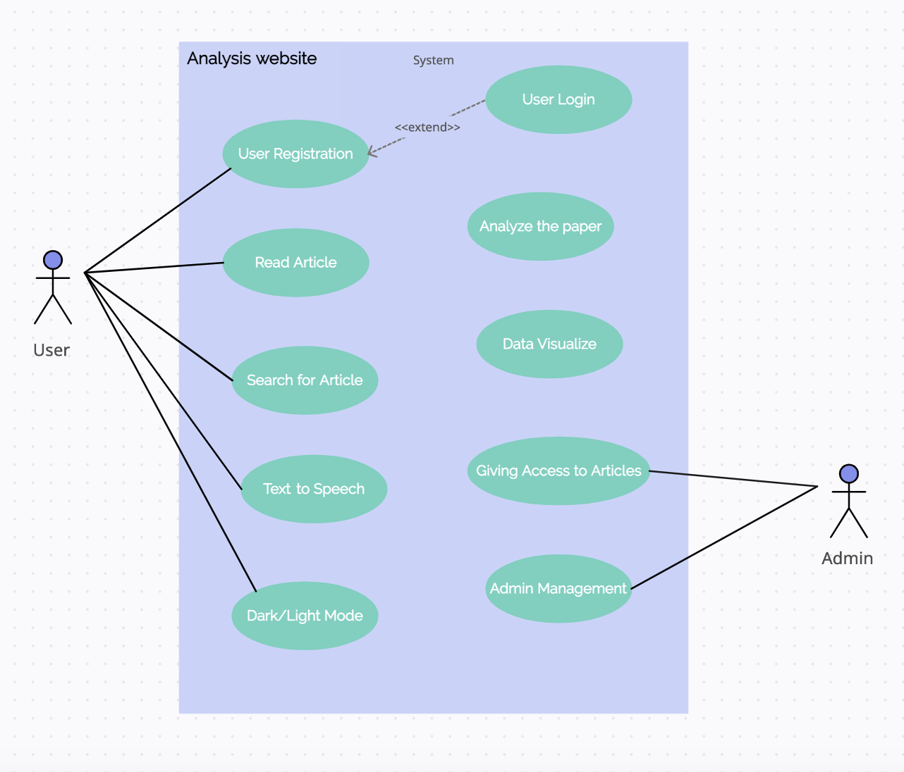
Use Case Diagram

Slide 11
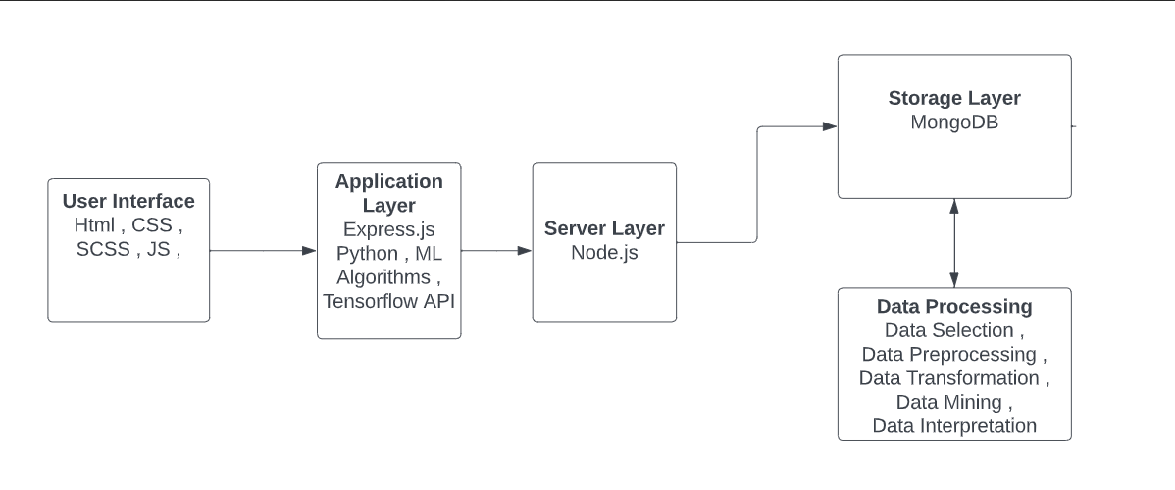
Architecture Diagram

Slide 12
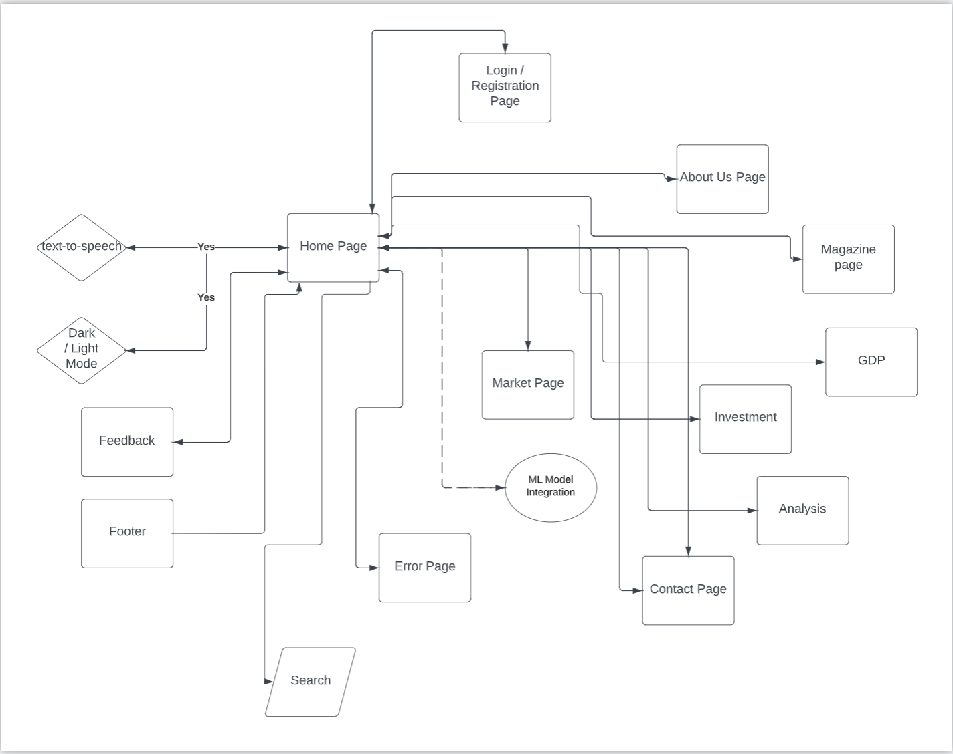
Flow Diagram

Slide 13

Unbiasedness : Data Sources

Slide 14

Self Created
Model for Assigning Priorities to Data Sources and
Calculating Priority Multiply Factor (PMF)

Slide 15
Data Sources Accuracy
We need to create a model which takes input as data sets composed of data sources and certain parameters like , its age , its acceptance , number of countries , accuracy of its past predictions and gives output as priority order of the data sources and also calculates priority multiply factor based on the given concept.
Priority Multiply Factor : It ranges from 0 to 1 ,where 0 is completely inaccurate and 1 is completely accurate .Based on values of priority multiply factor , the higher the value the more accurate the data source is.

Slide 16


Slide 17
Example Calculation
PMFI (World Bank) = (Age (Normalized) + number of countries(Normalized) + acceptance(Normalized) + …) / Number of Factors
PMF (World Bank) = Scaled down (PMFI)
Calculated GDP = GDP(World Bank) x PMF(World Bank) + GDP(RBI) x PMF(RBI) + …

Slide 18
Data-Sources/Economy Indicator | PMF | GDP (US $ Trillion) | PMF * GDP
World Bank | 0.70 | 3.2 | 2.240
IMF | 0.21 | 3.1 | 0.651
RBI | 0.09 | 3.9 | 0.351
GDP Predicted = 2.240 + 0.651 + 0.351 = 3.24 Trillion US$

Slide 19
#1 Machine Learning Model
Linear Regression

Slide 20
It models the relationship between a dependent variable and one or more independent variables.
In the context of predicting economic factors of a nation, we can use linear regression to model the relationship between input features, such as GDP, unemployment rate, and per capita income, and an output variable, such as real GDP or nominal GDP.
We assume that the relationship between the inputs and the output is linear, which means that we can approximate it using a straight line.
The goal of the model is to find the line that best fits the data, which means minimizing the difference between the predicted output values and the actual output values.

Slide 21
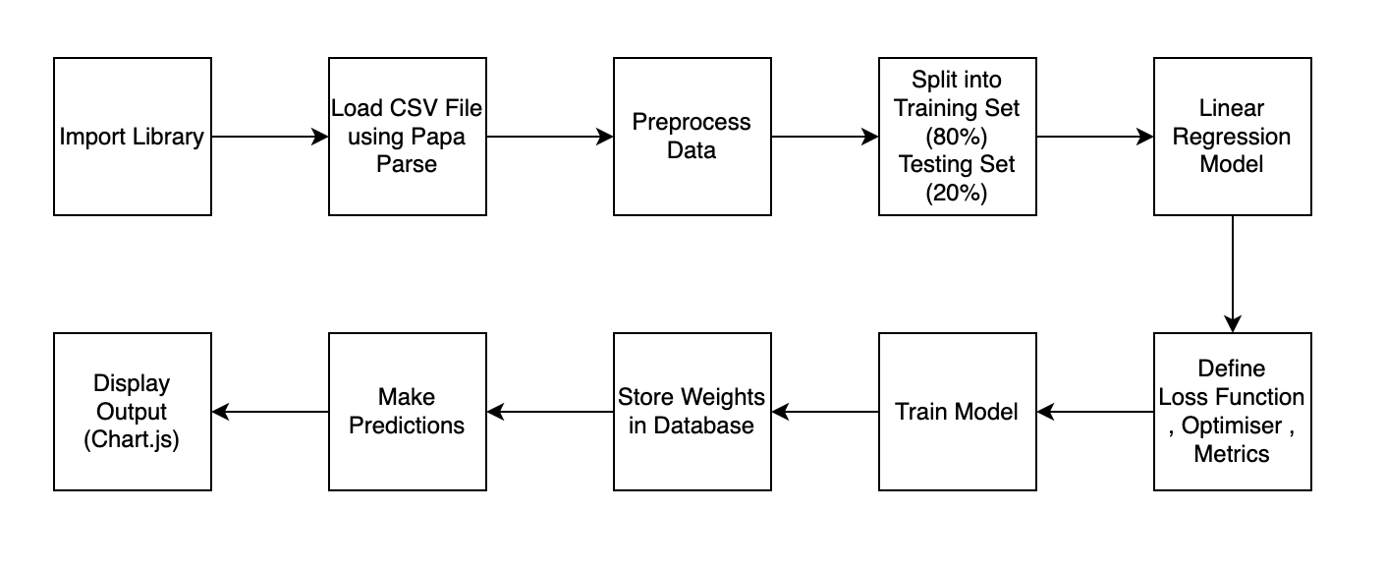
Algorithm (Linear Regression)

Slide 22
Machine Learning Model
#2

Slide 23
Decision Tree Model
Decision tree is a type of machine learning algorithm that creates a tree-like structure of decision nodes and leaf nodes to predict outcomes based on input features.
In the context of India's economy, decision tree models can be used to predict economic indicators such as GDP growth, inflation, unemployment, and income distribution.
One advantage of using a decision tree model is that it can be used to identify the most important factors that contribute to economic growth and development. By analyzing the decision nodes of the tree, we can gain insights into the underlying drivers of economic growth and identify areas for policy intervention and reform.
However, it can be prone to overfitting if the tree becomes too complex.

Slide 24
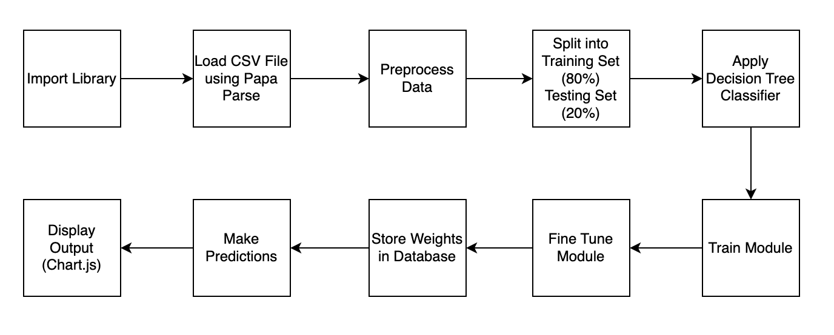
Algorithm (Decision Tree)

Slide 25
Text To Speech
Text-to-speech (TTS) is a technology that converts written text into spoken words.
The Web Speech API is a JavaScript API that provides developers with a way to add speech recognition and synthesis capabilities to web applications.
The Speech Synthesis API, a part of the Web Speech API, allows developers to add text-to-speech functionality to web applications by generating synthetic speech from text.
The Speech Synthesis API works by sending the text to a speech synthesis engine, which generates a digital audio file that contains the spoken words.
The API supports multiple voices and languages and can be used in various web applications.

Slide 26
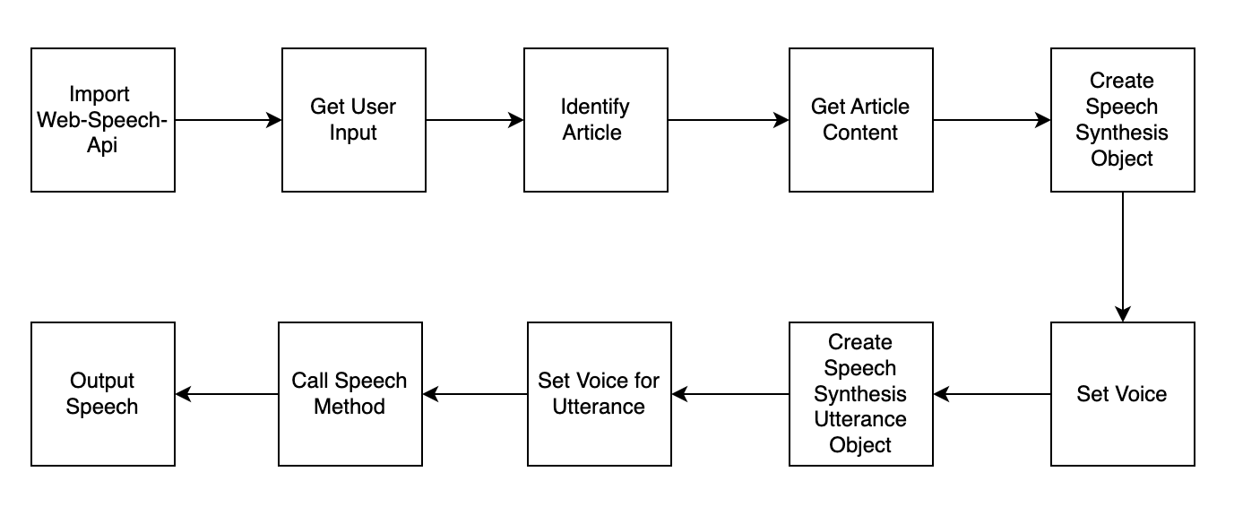
Algorithm(Text to Speech)

Slide 27
User Interface

Slide 28
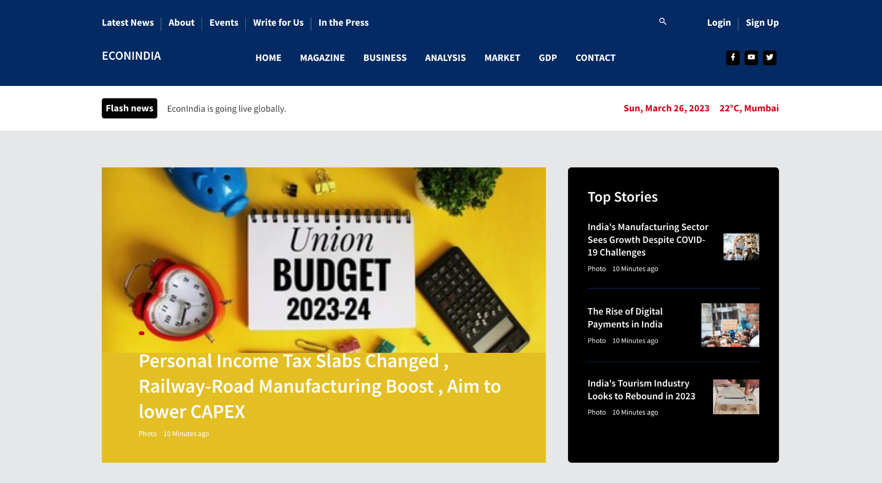

Slide 29
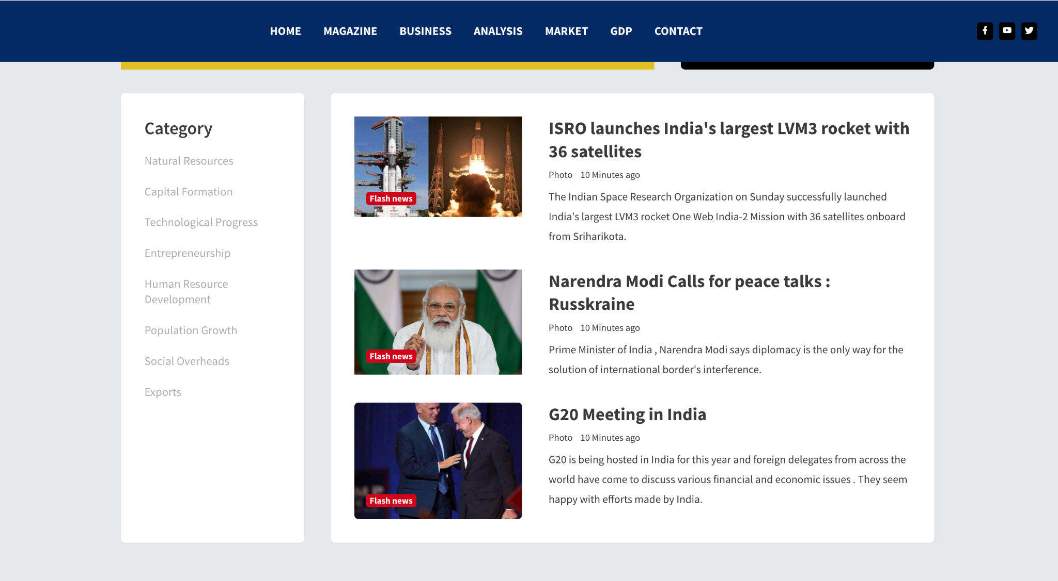

Slide 30
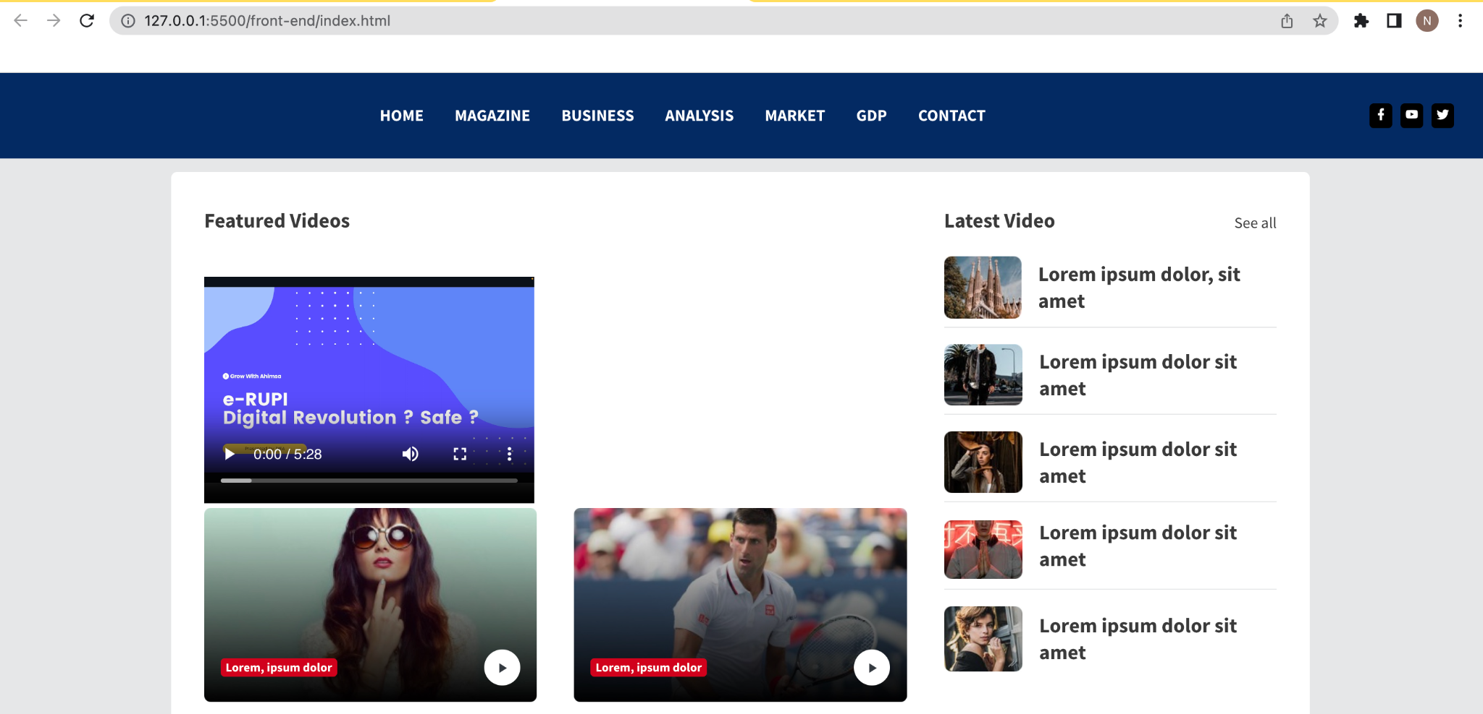

Slide 31
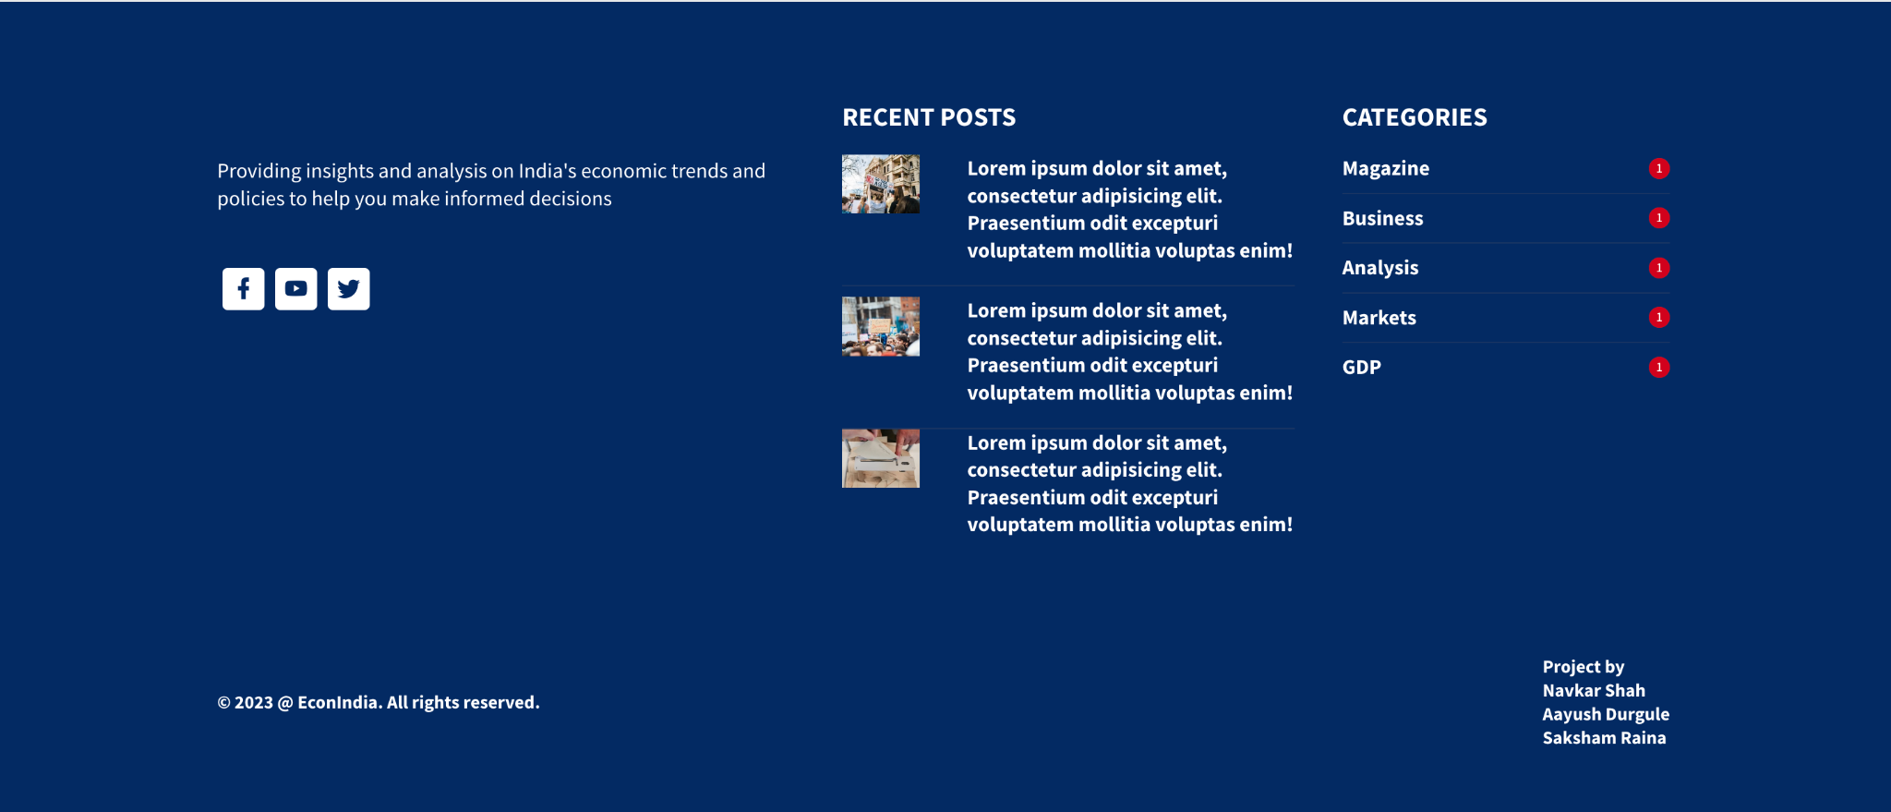

Slide 32
Hardware & Software Requirements
Hardware Requirements :
Computer , Smartphone , Tablet etc.
Ram (Minimum ) : 2 GB
Operating System : Android , Windows , Linux , Mac
Speaker/Handset (Internal or External ) : Optional
Software Requirements :
Chrome , Firefox or any other browser (JS enabled)
Internet Connection

Slide 33
Conclusion
Our website analyses the Indian economy and forecasts future patterns using machine learning algorithms and data processing techniques.
Our project is a useful resource for businesses and policymakers wanting data-driven insights for decision-making.

Slide 34
References
[1] A.Rajat Kathuria B.Mansi Kedia C.Sashank Kapilavai "IMPLICATIONS OF AI ON THE INDIAN ECONOMY" July 2020
[2] A.Mantas Lukauskas B.Vaida Pilinkiene C.Jurgita Bruneckiene D.Alina Stundžiene E.Andrius Grybauskas F. Tomas Ruzgas "Economic Activity Forecasting based on the Sentiment Analysis of News" 2022
[3] A. Sumangala A. Bafna1, B. Pratiksha, C. D. Dutonde, D. Shivani S. Mamidwar, Monali S. Korvate4, Prof. Dhiraj Shirbhare5“Review on Study and Usage of MERN Stack for Web Development” 2022
[4] A. Gwanhoo Lee “How Can the Artificial Intelligence of Things Create Public Value? Lessons Learned from Use Cases” 2019

Slide 35
References Continue
[5] A. NENAVATH SREENU, “Cashless Payment Policy and Its Effects on Economic Growth of India: An Exploratory Study” 2020
[6] A. Muhammad Anees Khan, B. Kumail Abbas, C. Mazliham Mohd Su’ud, D. Anas A. Salameh, E. Muhammad Mansoor Alam “Application of Machine Learning Algorithms for Sustainable Business Management Based on Macro-Economic Data: Supervised Learning Techniques Approach” 2022
[7] A. M.J.F. Korf, “Optimal Decision Trees in Economy (ML Algorithm)”, 2020
[8] A. Suriyan Jomthanachai1 B. Wai Peng Wong C. Khai Wah Khaw, “An application of machine learning regression to feature selection:a study of logistics performance and economic attribute” 2022

Slide 36
Thank You

